Slide 2
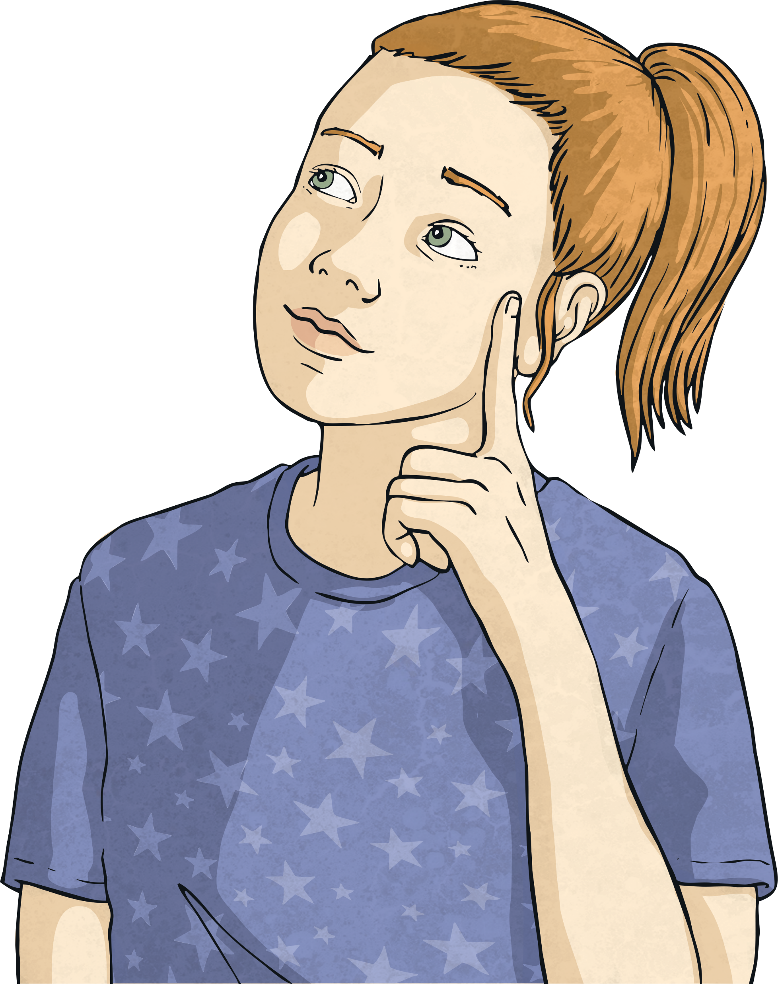
What Is a Limerick?
Limericks are light-hearted, funny poems with several common features.
Compare these two limericks.
What did you notice about the poems?
There once was a young man from Ealing,
Who would always hang from the ceiling.
He couldn’t wear a hat,
But could hang like a bat,
And said, “What a wonderful feeling!”
There was an old Martian named Zed,
With blue spots all over his head.
He sent out a lot,
Of di-di-dash-dot-dot,
But nobody knows what he said!

Slide 3
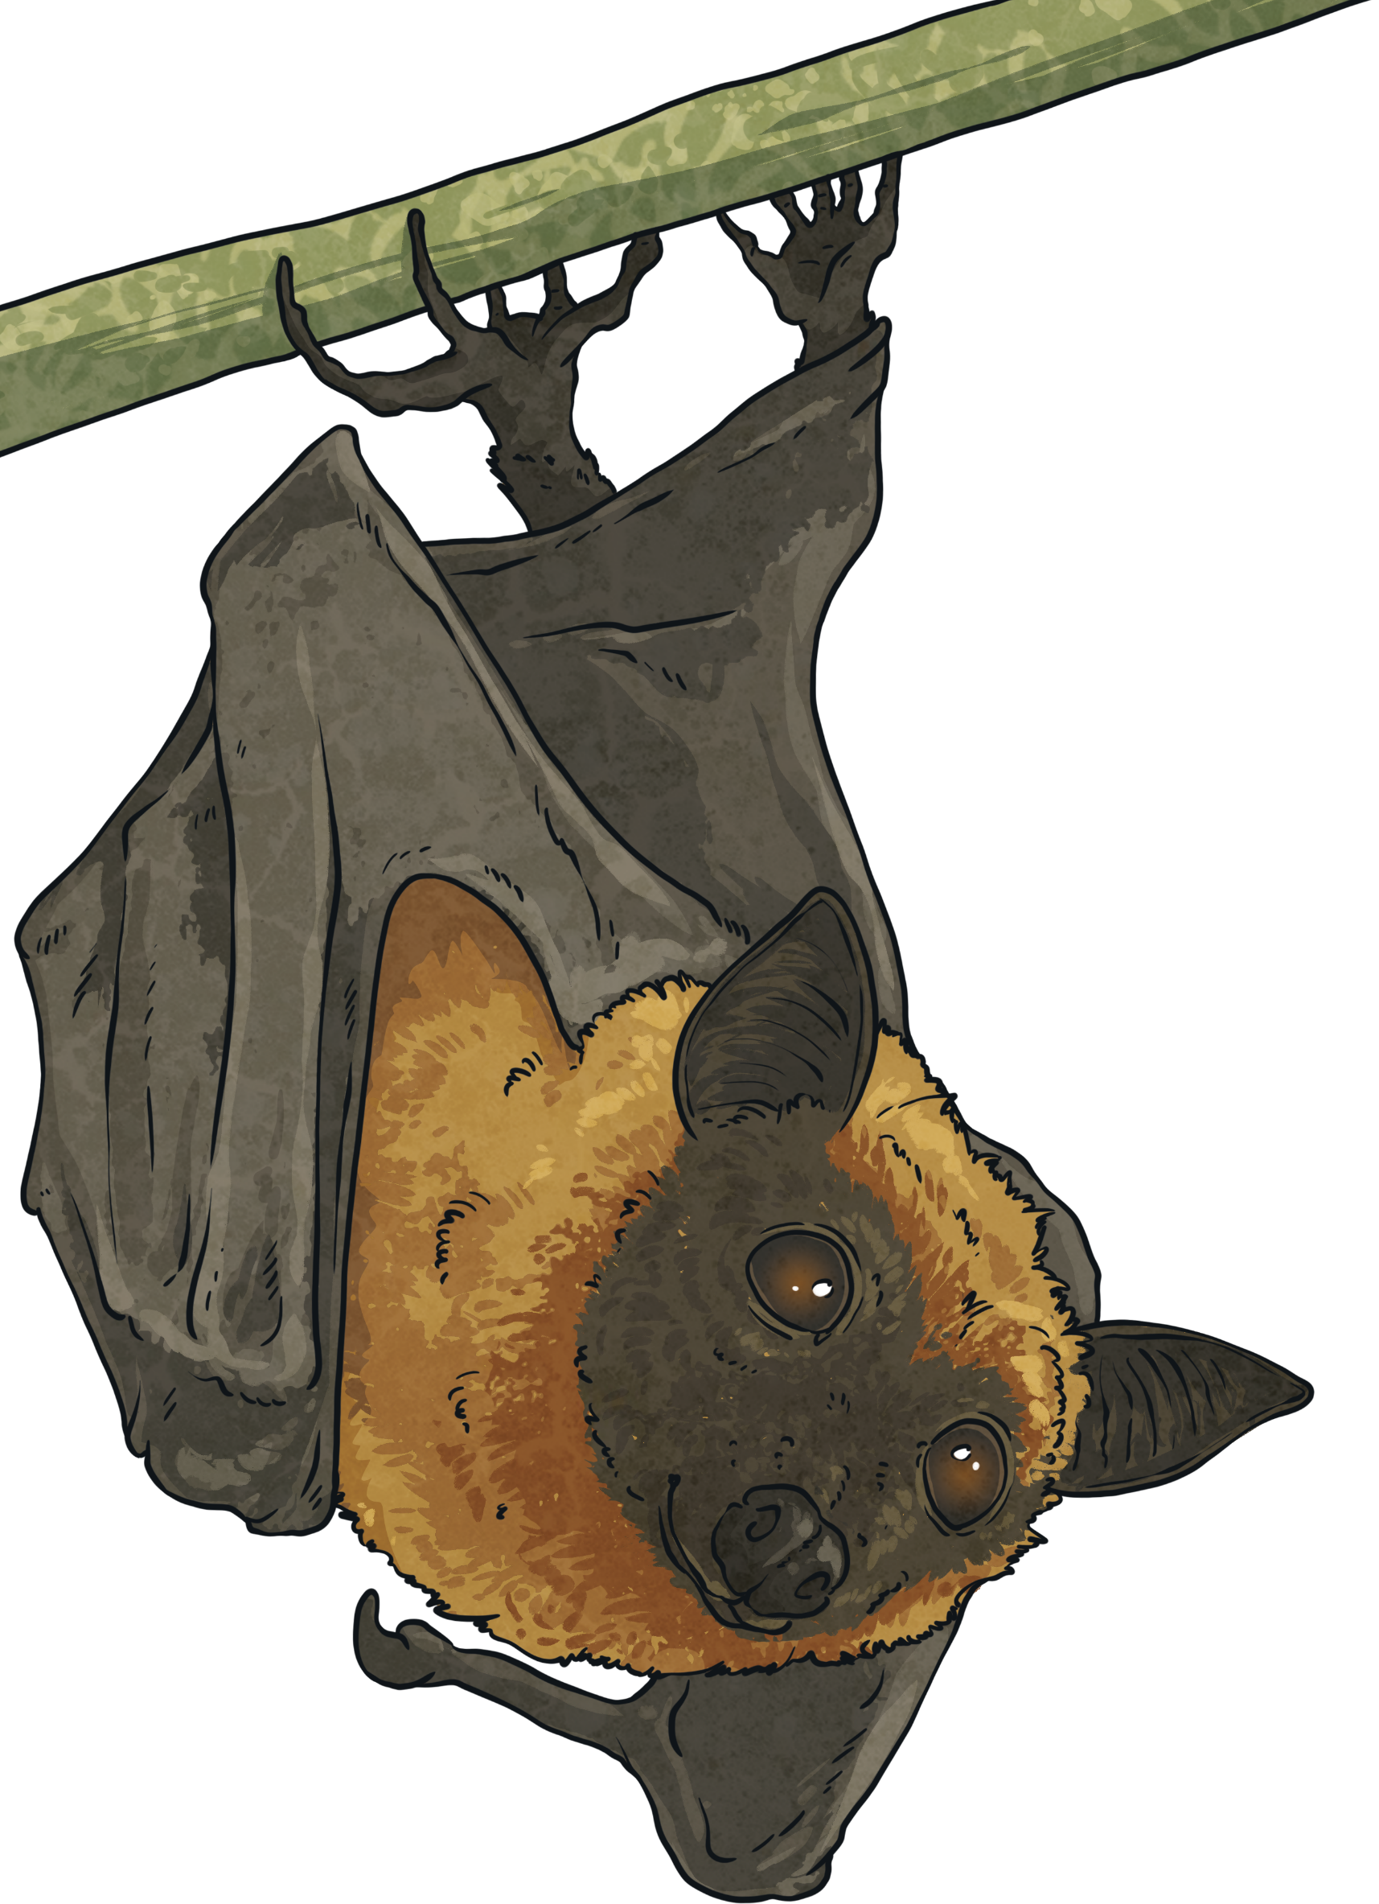
Limerick Features
What Is a Limerick?
There once was a young man from Ealing,
Who would always hang from the ceiling.
He couldn’t wear a hat,
But could hang like a bat,
And said, “What a wonderful feeling!”
There once was a young man from Ealing,
Who would always hang from the ceiling.
He couldn’t wear a hat,
But could hang like a bat,
And said, “What a wonderful feeling!”
Lines 1, 2 and 5 rhyme.
Lines 3 and 4 rhyme.
Lines 1, 2 and 5 are longer and usually have eight to ten syllables.
Lines 3 and 4 are
shorter and have five or six syllables.

Slide 4

Limerick Features
There once was a young man from Ealing,
Who would always hang from the ceiling.
He couldn’t wear a hat,
But could hang like a bat,
And said, “What a wonderful feeling!”
Limericks follow a typical rhythm:
di DUM di di DUM di DUM di (3 beats)
There once was a young man from Ealing,
Who would always hang from the ceiling.
He couldn’t wear a hat,
But could hang like a bat,
And said, “What a wonderful feeling!”
di DUM di di DUM di DUM di (3 beats)
di DUM di di DUM (2 beats)
di DUM di di DUM (2 beats)
di DUM di di DUM di DUM di (3 beats)

Slide 5
Limerick Features
There once was a young man from Ealing,
Who would always hang from the ceiling.
He couldn’t wear a hat,
But could hang like a bat,
And said, “What a wonderful feeling!”
Limericks follow a typical rhythm:
The first line sets up the subject so it usually ends with the name of a person or place.
The first line begins with a phrase starting with ‘There’, like this one.
The second line gives more details about the subject.
Line 3 gives us some action about the subject.
Line 4 gives us some more action about the subject.
The last line is usually the consequence of lines 3 and 4.

